Slide 1
Gradient-based acceleration for federated learning convergence.
①
②
③
Stale Gradients
Reschedule Gradients
Adaptive Bi-Directional Gradients
⑤
④
Gradient-based grouping method
Gradients with momentum
CPS Computational Learning Laboratory

Slide 2
②
Reschedule Gradients
①
③
Stale Gradients
Utilization of historical gradients
Adaptive Bi-Directional Gradients
Utilization of low-stale and high-stale gradients
Bi-directional vector with step size and direction
⑤
④
Gradient-based grouping method
Gradients with momentum
model-based and gradient-similarity grouping
Conveys the momentum of the global gradient to clients

Slide 3

Paper 1
Towards Efficient and Stable K-Asynchronous Federated Learning With Unbounded Stale Gradients on Non-IID Data
Zihao Zhou, Yanan Li , Xuebin Ren , and Shusen Yang
Published in: IEEE TRANSACTIONS ON PARALLEL AND DISTRIBUTED SYSTEMS
Published Time: 2022
CPS Computational Learning Laboratory

Slide 4
01
Problem Description
02
Method Design
03
Experiment Results
Contents
04
Conclusion
CPS Computational Learning Laboratory
Notes:
主要分为以下四个部分

Slide 5
01
Problem Description
02
Method Design
03
Experiment Results
Contents
04
Conclusion
CPS Computational Learning Laboratory
Notes:
首先是问题描述

Slide 6
Problem Description
Federated Learning faces challenges with non-IID data and stale gradients, which reduce model utility.
Non-IID data requires comprehensive gradients, while mitigating staleness demands consistent gradients.
A new mthod: two-stage weighted K-asynchronous FL (WKAFL) to balance both problems
Though K-async FL can mitigate the stragglers effect and save total training time, there are still two obstacles to be overcome in practice.
On the one hand, non-IID datasets generated at different FL clients can impact the model utility.
On the other hand, stale gradients may harm the model utility, or even diverge the training process The solutions to these two problems have been studied separately. For non-IID data, the essence of the existing solutions, e.g., momentum and variance reduction , is to fully utilize all available information for estimating the global data distribution.
CPS Computational Learning Laboratory

Slide 7
01
Problem Description
02
Method Design
03
Experiment Results
Contents
04
Conclusion
CPS Computational Learning Laboratory

Slide 8
Method Design
WKAFL, a two-stage algorithm.
In stage one, consistent gradients are selected to accelerate training.
In stage two, large-norm gradients are clipped to stabilize the model.
The learning rate is adaptively adjusted based on staleness.
Key Components:
Gradient Selection: Pick gradients with consistent descent directions.
Learning Rate Adaptation: Adjust the learning rate based on staleness.
Weighted Aggregation: Assign weights to gradients based on their consistency and staleness.
CPS Computational Learning Laboratory

Slide 9
Method Design
K sync FL
K Async FL
FedAvg is one of the most classical FL algorithms and runs in a synchronous manner.
At each iteration, the clients complete several local training processes and upload the model parameter.
The server randomly samples a portion of clients and aggregates their locally updated models.
In such a case, the runtime of each FL iteration is determined by the stragglers , who are the sampled slowest clients.
To alleviate the stragglers effect, the server can update the global model once receiving the fastest K gradients out of total clients, namely, K-sync FL or K-batch-sync FL.
However, these approaches can not eradicate stragglers due to the unpredictable statuses of sampled clients and network communication.
Besides the above synchronous methods, the K asynchronous FL (K-async FL) has also been extensively studied, in which the server updates the global model once receiving the gradients from the first K clients and those clients who fail to participate in current iteration can continue their training for reducing the runtime in the next iteration.
K-async FL can not only alleviate stragglers, but also save the total training time when the iteration time of clients follows a new-longer-than-used distribution.
Therefore, compared to K-sync FL, K-async FL has demonstrated great benefits of achieving more efficient learning in highly heterogeneous systems. In this paper, we focus on achieving both efficient and high-utility K-async FL.
CPS Computational Learning Laboratory

Slide 10
Method Design
Though stale gradients may cause the model to diverge, Mitliagkas et al. found that stale gradients can help converge faster and they leveraged staleness to accelerate the training process.
However, not all gradients can speed up convergence.
low-stale gradients are more likely to have a consistent descent direction and accelerate the training process
high-stale gradients may have different directions and the biased gradients will prevent model convergence.
CPS Computational Learning Laboratory

Slide 11
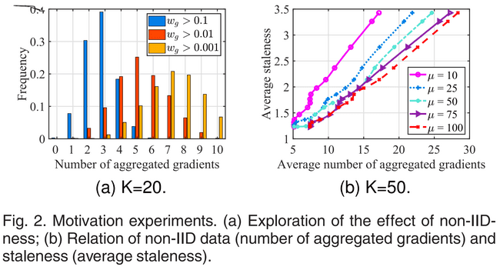
Method Design
Observation: Fig shows the negative correlation between non-IID data and staleness, validating the inherent conflict.
Goal: Design a new algorithm that can mitigate non-IID data while effectively handling stale gradients.
CPS Computational Learning Laboratory

Slide 12
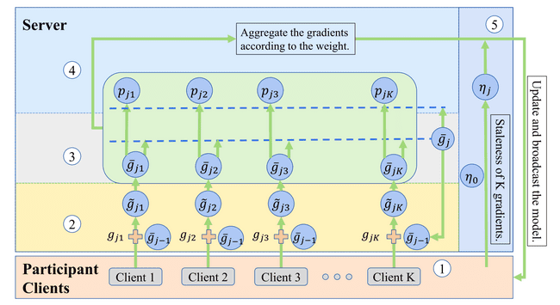
Method Design
Fig. 3. WKAFL with five main components, one for clients (①) and four for the server (②-⑤).
Gradients computation.
Improvement of stability on non-IID data.
Estimation of globally unbiased gradient.
Selection and aggregation of consistent gradients.
Learning rate adaptation.
CPS Computational Learning Laboratory

Slide 13
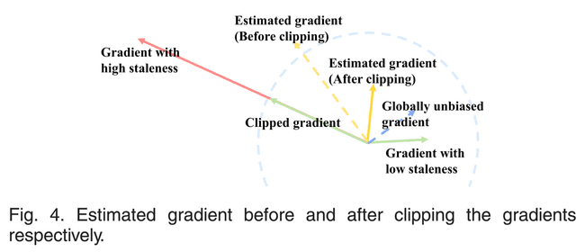
Method Design
CPS Computational Learning Laboratory

Slide 14
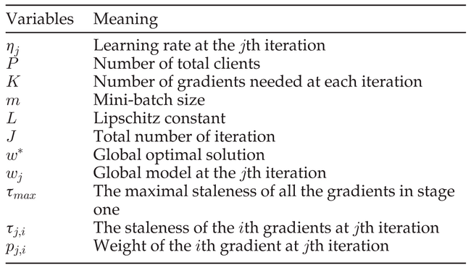
Method Design
CPS Computational Learning Laboratory

Slide 15
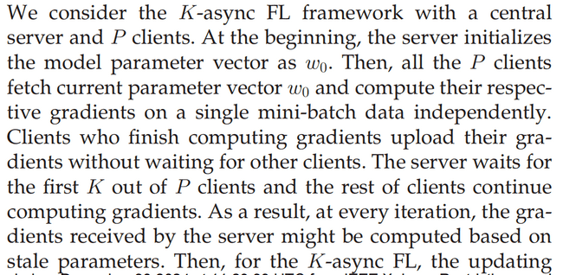
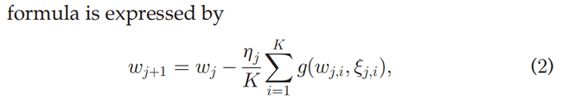
Method Design
CPS Computational Learning Laboratory

Slide 16
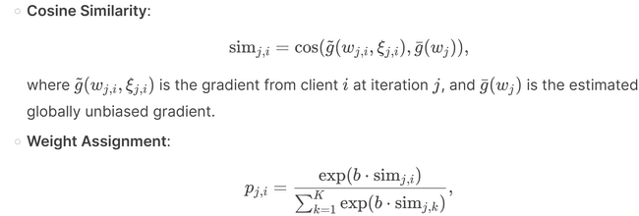
Method Design
stage one
CPS Computational Learning Laboratory

Slide 17
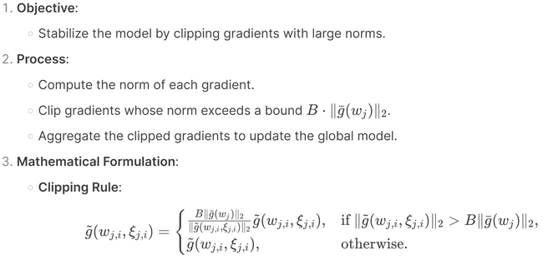
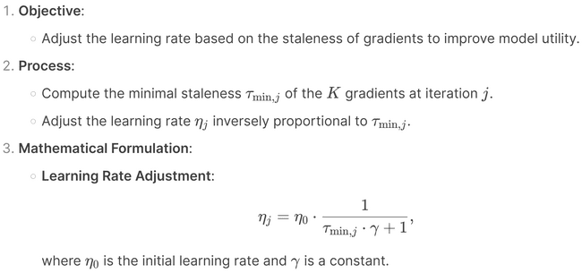
Method Design
stage two
CPS Computational Learning Laboratory

Slide 18
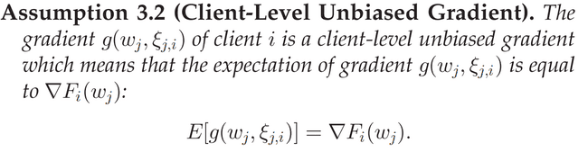
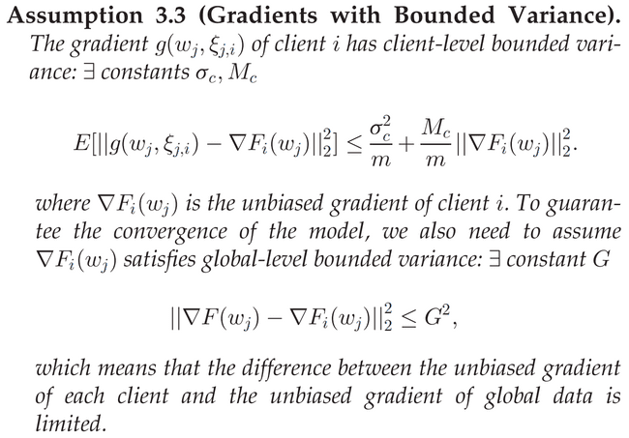
Method Design
无偏梯度的说明
梯度方差的上下界
CPS Computational Learning Laboratory

Slide 19
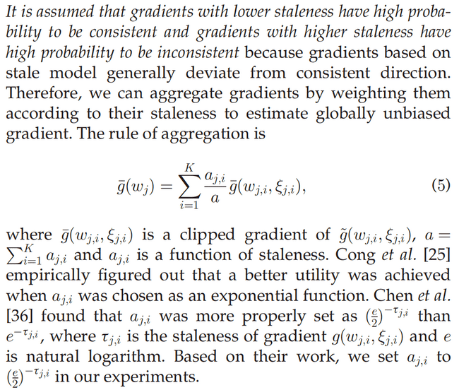
Method Design
全局无偏梯度的计算
CPS Computational Learning Laboratory

Slide 20
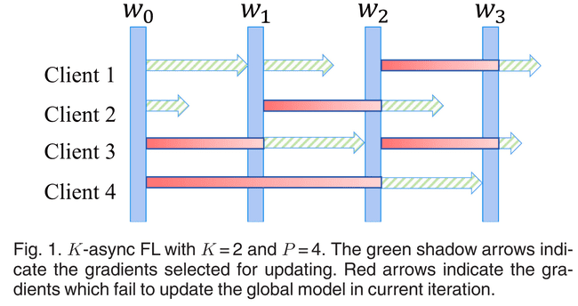

Method Design
Fig. 1 illustrates the two-async FL when the total number of clients is four.
At each iteration, four clients independently upload gradients to the server after finishing computing gradients.
The server will update the global model once receiving any two gradients,
clients who fail to upload gradients in limited time continue computing gradients based on a local mini-batch.
After updating the global model, the server broadcasts the new model parameters to the clients who upload their gradients.
CPS Computational Learning Laboratory

Slide 21
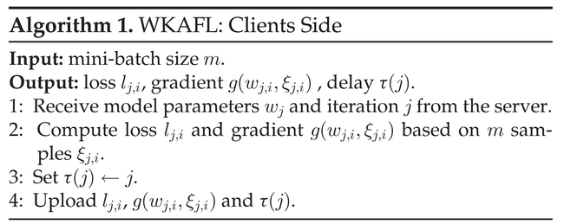
Method Design
考虑到梯度陈旧性
CPS Computational Learning Laboratory

Slide 22
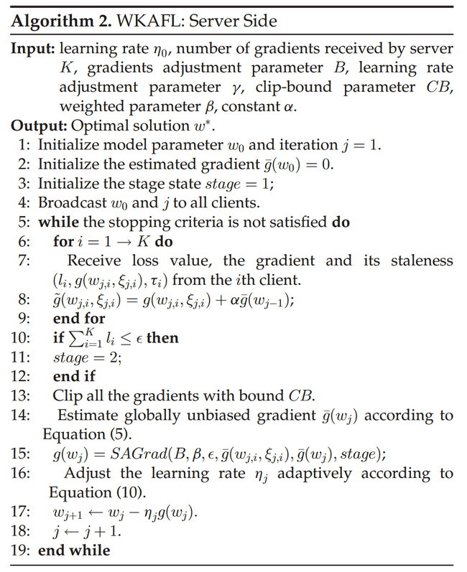
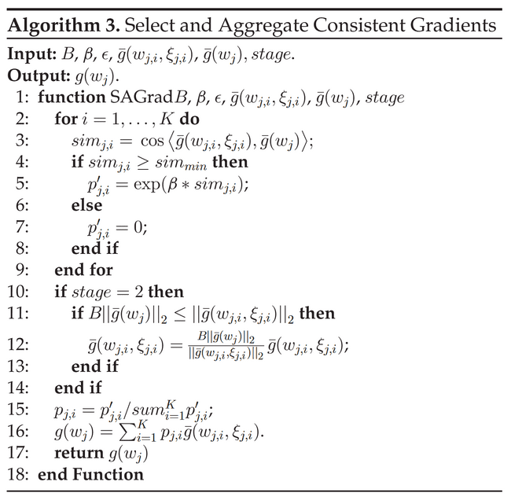
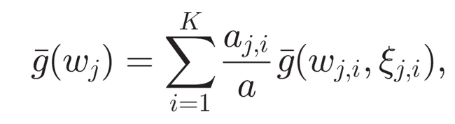
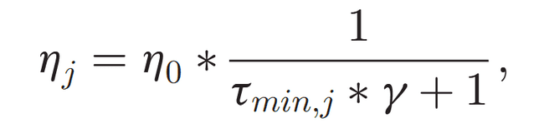
Method Design
CPS Computational Learning Laboratory

Slide 23
01
Problem Description
02
Method Design
03
Experiment Results
Contents
04
Conclusion
CPS Computational Learning Laboratory

Slide 24
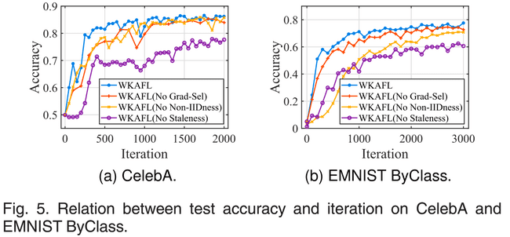
Experiment Results
CelebA and EMNIST ByClass
CPS Computational Learning Laboratory

Slide 25
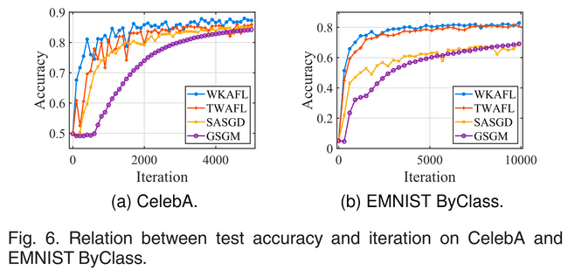
Experiment Results
CelebA and EMNIST ByClass
CPS Computational Learning Laboratory

Slide 26
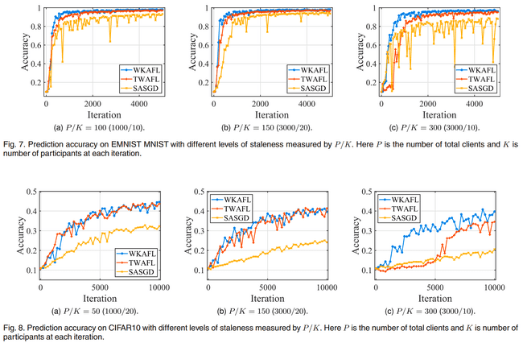
Experiment Results
CPS Computational Learning Laboratory

Slide 27
01
Problem Description
02
Method Design
03
Experiment Results
Contents
04
Conclusion
CPS Computational Learning Laboratory
CPS Computational Learning Laboratory
2
18

Slide 28
Conclusion
First, WKAFL estimates the globally unbiased gradient by accumulating historical gradients to alleviate the impact of non-IID data and aggregating K gradients based on the staleness.
Second, WKAFL picks gradients consistent with the estimated gradient and assigns them with a high weight and vice versa to improve the effect for mitigating non-IID data while preventing the stale gradients to bring down model utility.
Third, by further clipping the stale gradient in the second stage and adjusting the learning rate based on staleness, WKAFL improves the final prediction accuracy.
CPS Computational Learning Laboratory

Slide 29
Paper 2
Reschedule Gradients:
Temporal Non-IID Resilient Federated Learning
Xianyao You , Ximeng Liu , Nan Jiang , Jianping Cai , and Zuobin Ying
Publish Journal: IEEE INTERNET OF THINGS JOURNAL
Published Time: 2023
CPS Computational Learning Laboratory
Notes:
基于深度强化学习的柔性作业车间动态调度

Slide 30
01
Problem Description
02
Method Design
03
Experiment Results
Contents
04
Conclusion
CPS Computational Learning Laboratory
Notes:
主要分为以下四个部分

Slide 31
01
Problem Description
02
Method Design
03
Experiment Results
Contents
04
Conclusion
CPS Computational Learning Laboratory
Notes:
首先是问题描述

Slide 32
Problem Description
1. Problem Background
Challenges in Federated Learning: In real-world environments, client data distributions are often non-IID, making model training difficult to converge.
Temporal Non-IID Problem: Data distributions of clients may vary over time, further complicating model training.
2. Existing Solutions for Non-IID Federated Learning
FedAvg: The baseline federated learning method, which directly averages gradients from clients. However, it struggles with non-IID data.
FedProx: Adds a regularization term to the client-side loss function to reduce model drift. Limited performance gain in temporal non-IID scenarios.
FedAwS: Designed for scenarios where clients have only one class of data. Uses regularization to maximize distances between embedding vectors, but does not address temporal non-IID.
CPS Computational Learning Laboratory

Slide 33
01
Problem Description
02
Method Design
03
Experiment Results
Contents
04
Conclusion
CPS Computational Learning Laboratory
Notes:
研究现状

Slide 34
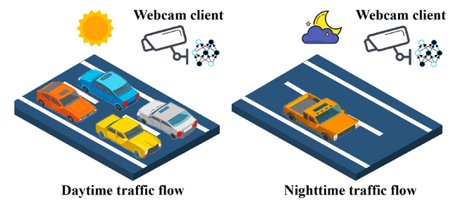
Method Design
Temporal Non-IID in Federated Learning
In temporal non-IID scenarios, the data distribution of clients changes over time, leading to heterogeneous data across different training rounds.
CPS Computational Learning Laboratory

Slide 35
Method Design
Limitations of Existing Methods Focus on Intra-Round Non-IID:
Most existing methods address non-IID issues within the same round of training but do not consider temporal non-IID across rounds.
Lack of Temporal Adaptation: Existing methods fail to handle the dynamic changes in data distributions over time, leading to poor convergence in temporal non-IID scenarios.
Solution: FedGS (Federated Gradient Scheduling)
Core Idea: Improve the utilization of historical gradients to address temporal non-IID issues, enhancing model convergence speed and performance.
CPS Computational Learning Laboratory

Slide 36
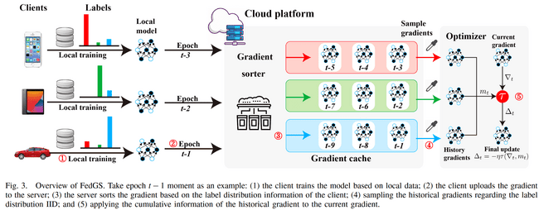
Method Design
Client Pre Clustering: Cluster clients based on their label distributions to group similar clients together.
Gradient Sampling: Sample gradients from each cluster to create an IID-like gradient set for the optimizer.
CPS Computational Learning Laboratory

Slide 37
Method Design
Optimizer Integration: Modify existing optimizers (e.g., AdamW, AMSGrad) to utilize the sampled gradients effectively.
CPS Computational Learning Laboratory

Slide 38
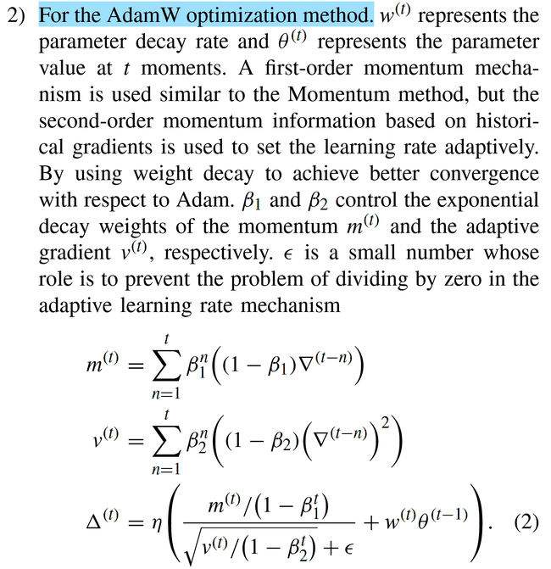
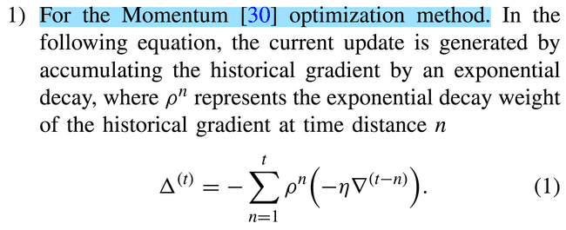
Method Design
Optimization Methods Using Historical Gradients
仅是梯度的加权聚合
考虑了一阶矩和二阶矩
CPS Computational Learning Laboratory

Slide 39
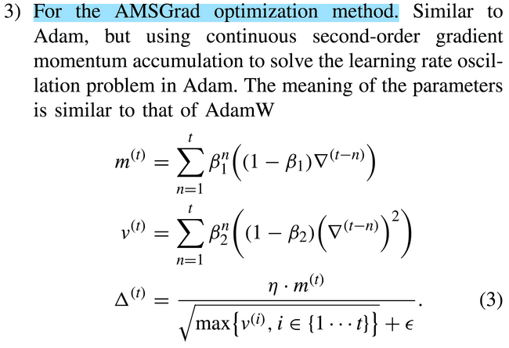
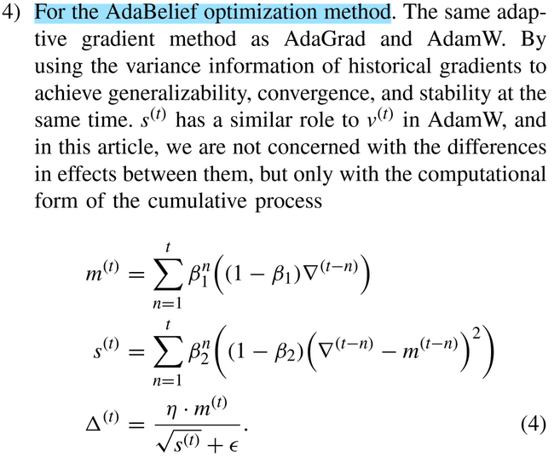
Method Design
使用了连续的二阶矩梯度动量
考虑到历史梯度的方差信息
CPS Computational Learning Laboratory

Slide 40
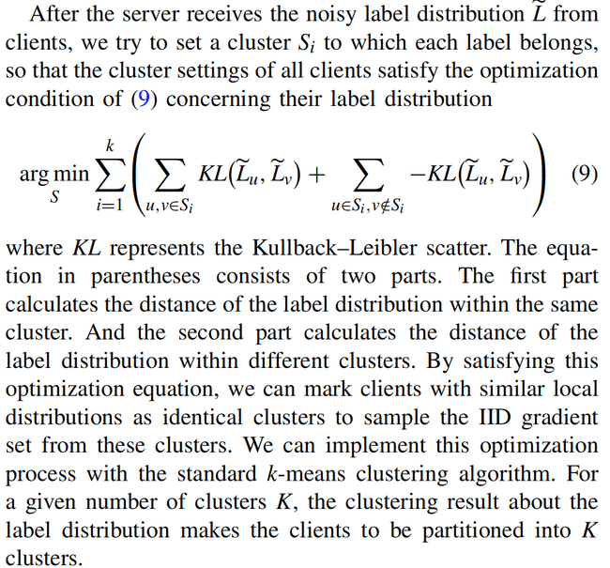
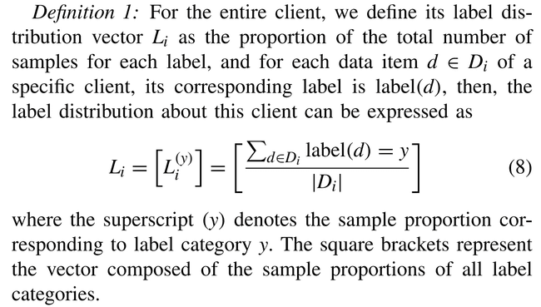
Method Design
利用KL散度进行聚类
定义标签分布向量
CPS Computational Learning Laboratory

Slide 41
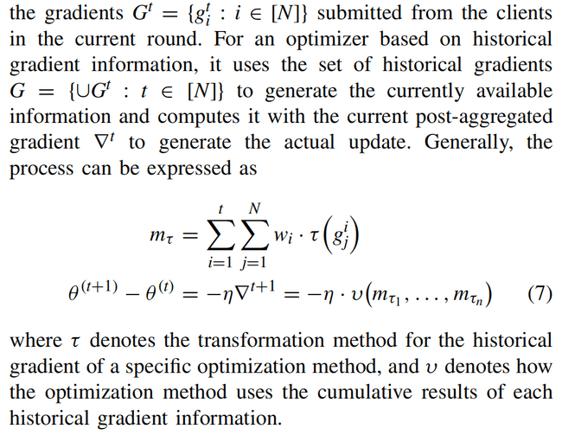
Method Design
CPS Computational Learning Laboratory

Slide 42
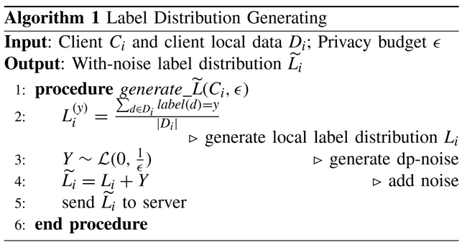
Method Design
添加拉普拉斯噪声
CPS Computational Learning Laboratory

Slide 43
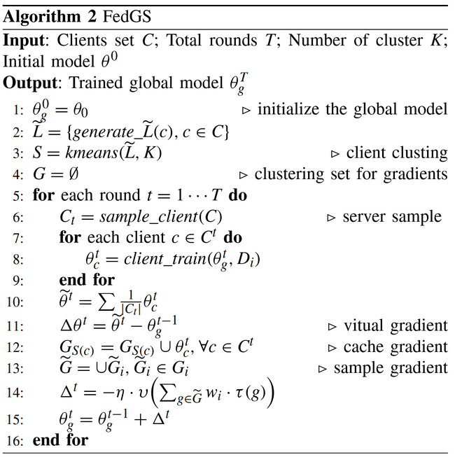
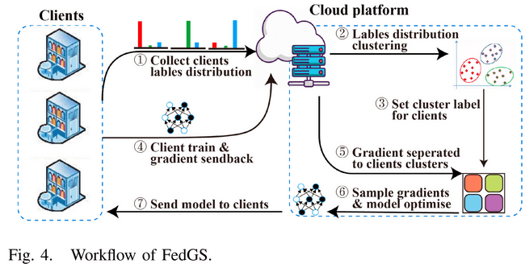
Method Design
CPS Computational Learning Laboratory

Slide 44
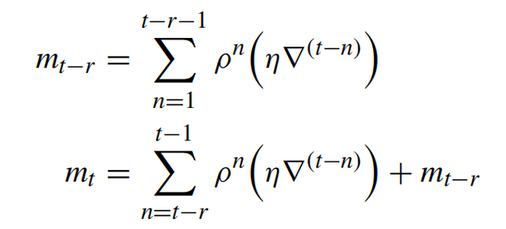
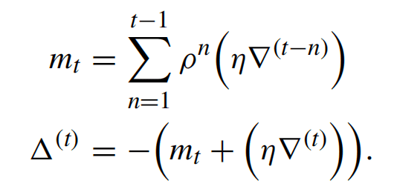
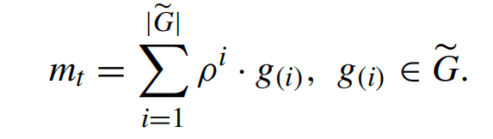
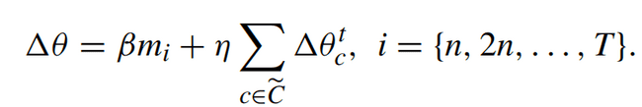
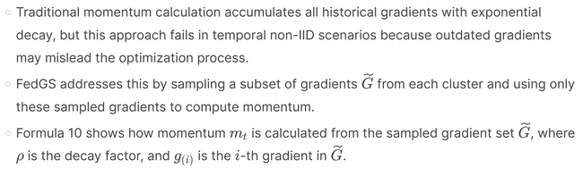
Method Design
CPS Computational Learning Laboratory

Slide 45
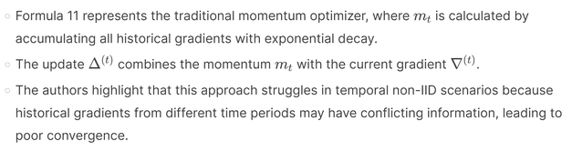
Method Design
CPS Computational Learning Laboratory

Slide 46
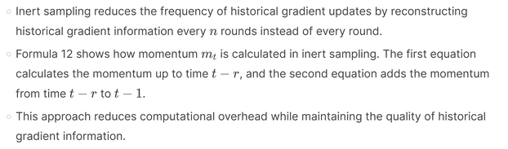
Method Design
CPS Computational Learning Laboratory

Slide 47
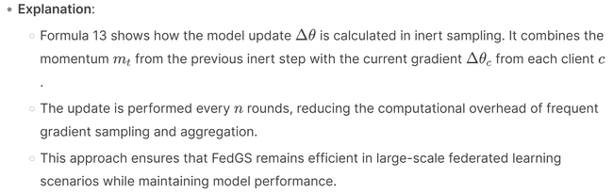
Method Design
CPS Computational Learning Laboratory

Slide 48
01
Problem Description
02
Method Design
03
Experiment Results
Contents
04
Conclusion
CPS Computational Learning Laboratory

Slide 49
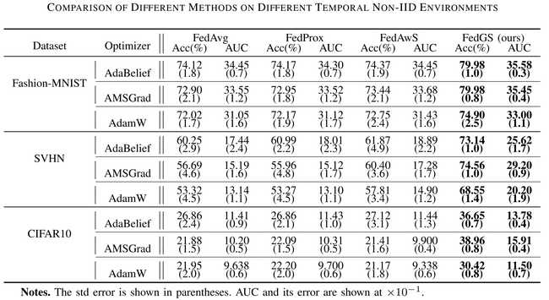
Method Design
CPS Computational Learning Laboratory

Slide 50
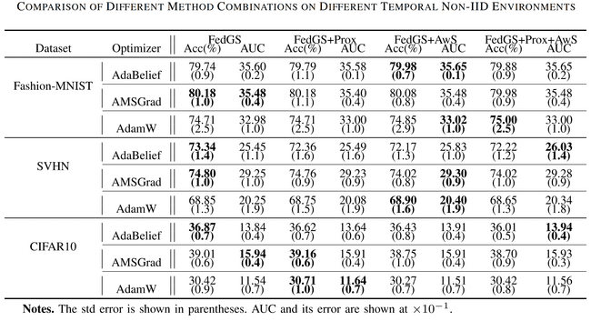
Method Design
CPS Computational Learning Laboratory

Slide 51
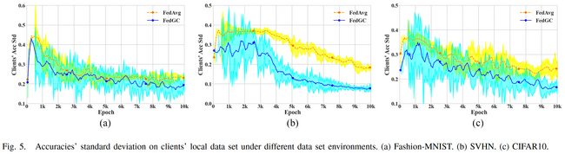
Method Design
CPS Computational Learning Laboratory

Slide 52
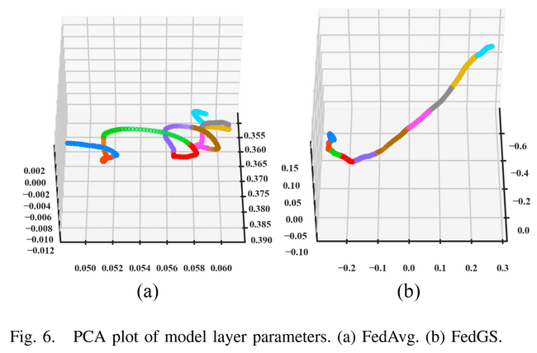
Method Design
CPS Computational Learning Laboratory

Slide 53
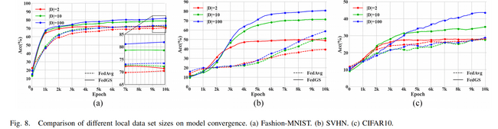
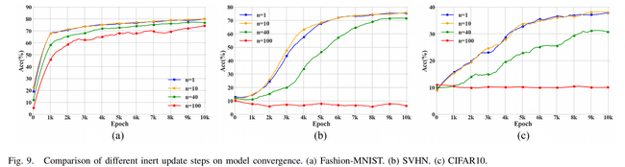
Method Design
CPS Computational Learning Laboratory

Slide 54
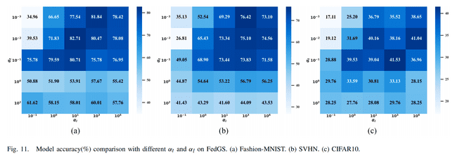
Method Design
CPS Computational Learning Laboratory

Slide 55
01
Problem Description
02
Method Design
03
Experiment Results
Contents
04
Conclusion
CPS Computational Learning Laboratory
CPS Computational Learning Laboratory
2
18

Slide 56
Future Work
Contributions
Due to the problem of data heterogeneity under federated learning, optimizers it incorporates may have difficulty extracting valid gradient information and perform poorly.
a novel method to provide an approximate IID historical gradient to optimizers by indirectly clustering the historical gradient under federated learning using clients’ label distribution information.
CPS Computational Learning Laboratory

Slide 57
Paper 3
FedVeca: Federated Vectorized Averaging on Non-IID Data With Adaptive Bi-Directional Global Objective
Ping Luo , Jieren Cheng , Member, N. Xiong , Zhenhao Liu, and Jie Wu
Publish Journal:IEEE TRANSACTIONS ON PARALLEL AND DISTRIBUTED SYSTEMS
Published Time: 2024
CPS Computational Learning Laboratory

Slide 58
01
Problem Description
02
Method Design
03
Experiment Results
Contents
04
Conclusion
CPS Computational Learning Laboratory
Notes:
主要分为以下四个部分

Slide 59
01
Problem Description
02
Method Design
03
Experiment Results
Contents
04
Conclusion
CPS Computational Learning Laboratory

Slide 60
Problem Description
The systems Non-Independent and Identically Distributed (Non-IID) data negatively affect the communication efficiency, since clients with different datasets may cause significant gaps to the local gradients in each communication round.
FL local training generally adopts the optimization method of Stochastic Gradient Descent (SGD), which requires independent and identically distributed (IID) data to ensure unbiased estimation of global gradient in the training process.
Since the clients' local data are obtained from the local environment and usage habits, the generated datasets are usually Non-IID due to differences in size and distribution.
The Non-IID datasets and multiple local SGD iterations will bring a drift to the global model in each communication round, which significantly reduces the FL performance and stability in the training process, thus requiring more communication rounds to converge or even fail to converge.
CPS Computational Learning Laboratory

Slide 61
01
Problem Description
02
Method Design
03
Experiment Results
Contents
04
Conclusion
CPS Computational Learning Laboratory
Notes:
研究现状

Slide 62
Method Design
In this article, we propose a Federated Vectorized Averaging (FedVeca) method to optimizethe FL communication system on Non-IID data.
we set a novel objective for the global model which is related to the local gradients. The local gradient is defined as a bi-directional vector with step size and direction, where the step size is the number of local updates and the direction is divided into positive and negative according to our definition.
In FedVeca, the direction is influenced by the step size, thus we average the bi-directional vectors to reduce the effect of different step sizes.
CPS Computational Learning Laboratory
Notes:
iid与non-iid

Slide 63
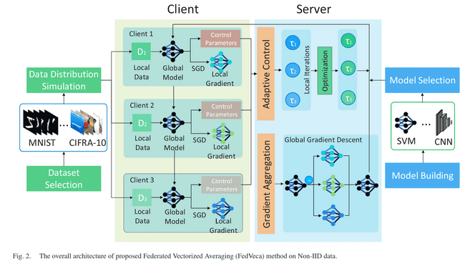
Method Design
CPS Computational Learning Laboratory

Slide 64
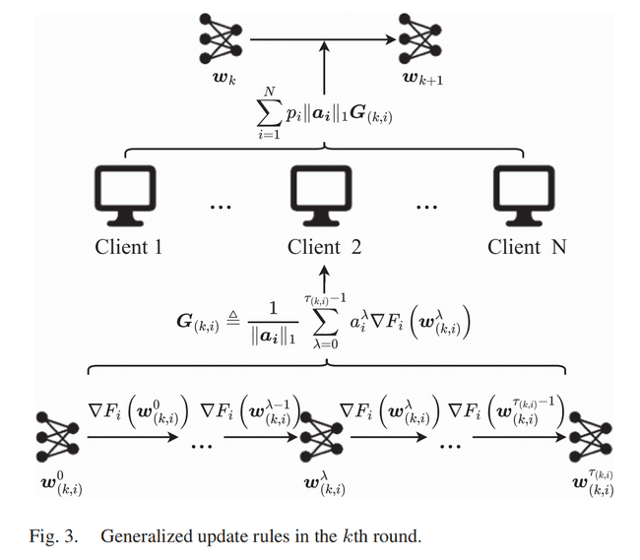

Method Design
CPS Computational Learning Laboratory

Slide 65

Method Design
Positive vectors represent local gradients that exhibit less deviation from the global gradient vector
Negative vectors indicate a greater disparity.
本地SGD更新
CPS Computational Learning Laboratory

Slide 66


Method Design
模型收敛条件
步长更新公式
CPS Computational Learning Laboratory

Slide 67






Method Design
CPS Computational Learning Laboratory

Slide 68



Method Design
平滑参数
误差参数
CPS Computational Learning Laboratory

Slide 69
01
Problem Description
02
Method Design
03
Experiment Results
Contents
04
Conclusion
CPS Computational Learning Laboratory

Slide 70

Experiment Results
CPS Computational Learning Laboratory

Slide 71

Experiment Results
CPS Computational Learning Laboratory

Slide 72

Experiment Results
CPS Computational Learning Laboratory

Slide 73

Experiment Results
CPS Computational Learning Laboratory

Slide 74
01
Problem Description
02
Method Design
03
Experiment Results
Contents
04
Conclusion
CPS Computational Learning Laboratory
CPS Computational Learning Laboratory
2
18

Slide 75
Future Work
Contributions
In order to improve the training efficiency of Federated Learning on the Non-IID dataset in communication networks, this
paper proposed an method that is based on FedNova algorithm and controls the number of local SGD iterations on clients to
obtain the optimal global training models in each communication round.
Analyze the mathematical relationships between the number of local SGD iterations and the global objective in a round, and design an adaptive control algorithm from this relationship to predict the number of local SGD iterations on each client for the next round.
Smoothing parameters and error parameters are nice innovations
CPS Computational Learning Laboratory

Slide 76
Paper 4
Communication-Efficient Federated Learning with
Accelerated Client Gradient
Geeho Kim, Jinkyu Kim, Bohyung Han
Published in: IEEE/CVF Conference on Computer Vision and Pattern Recognition (CVPR)
Published Time: 2024
CPS Computational Learning Laboratory

Slide 77
01
Problem Description
02
Method Design
03
Experiment Results
Contents
04
Conclusion
CPS Computational Learning Laboratory
Notes:
主要分为以下四个部分

Slide 78
01
Problem Description
02
Method Design
03
Experiment Results
Contents
04
Conclusion
CPS Computational Learning Laboratory
Notes:
首先是问题描述

Slide 79
Problem Description
Federated learning faces two key challenges: high heterogeneity in training data distributed over clients and limited client participation rates.
Several studies have shown that multiple local up-dates in the clients with non-i.i.d. (independent and identically distributed) data lead to client model drift.
Such a phenomenon introduces a high variance issue in FedAvg steps for global model updates, which hampers convergence to the optimal average loss over all clients. The challenge related to client model drift is exacerbated when the client participation rate per communication round is low.
Federated averaging with Accelerated Client Gradient (FedACG), which conveys the momentum of the global gradient to clients and enables the momentum to be incorporated into the local updates in the individual clients.
CPS Computational Learning Laboratory

Slide 80
01
Problem Description
02
Method Design
03
Experiment Results
Contents
04
Conclusion
CPS Computational Learning Laboratory
Notes:
研究现状

Slide 81
Method Design
Federated Learning (FL) struggles with slow and unstable convergence due to client data heterogeneity and low participation rates. Non-i.i.d. data distributions cause client model drift, where local updates diverge, leading to high variance in global model updates. This issue worsens with low client participation, as the aggregated information becomes less representative.
The paper introduces Federated Averaging with Accelerated Client Gradient (FedACG), a framework that enhances client consistency and global model convergence.
FedACG broadcasts a global model with a lookahead gradient, enabling clients to align local updates with the global loss trajectory.
CPS Computational Learning Laboratory

Slide 82

Method Design
Figure 1. An illustration of the proposed accelerated client gradient method. We first partially update the global model in the direction of the global momentum (orange) and then aggregate local updates (gray), resulting in the server model in the next round(blue).
This anticipatory update aligns individual local updates with the global gradient, achieving speed-up of convergence.
CPS Computational Learning Laboratory

Slide 83


Method Design
正则化方法
改进的动量方法
CPS Computational Learning Laboratory
Notes:
图1给出了所提出的HMAPPO在不同时空水平上的总体操作机制。objective agent充当周期性地调整较高目标的较高控制器。作业智能体和机器智能体是底层执行者，在每个重调度点分别选择可行的作业选择规则和机器分配规则，以达到更高的目标。

Slide 84

Method Design
CPS Computational Learning Laboratory
Notes:
图1给出了所提出的HMAPPO在不同时空水平上的总体操作机制。objective agent充当周期性地调整较高目标的较高控制器。作业智能体和机器智能体是底层执行者，在每个重调度点分别选择可行的作业选择规则和机器分配规则，以达到更高的目标。

Slide 85
01
Problem Description
02
Method Design
03
Experiment Results
Contents
04
Conclusion
CPS Computational Learning Laboratory

Slide 86

Experiment Results
CPS Computational Learning Laboratory

Slide 87

Experiment Results
CPS Computational Learning Laboratory

Slide 88

Experiment Results
CPS Computational Learning Laboratory

Slide 89

Experiment Results
CPS Computational Learning Laboratory

Slide 90

Experiment Results
CPS Computational Learning Laboratory

Slide 91


Experiment Results
CPS Computational Learning Laboratory

Slide 92
01
Problem Description
02
Method Design
03
Experiment Results
Contents
04
Conclusion
CPS Computational Learning Laboratory
CPS Computational Learning Laboratory
2
18

Slide 93
Conclusion
Contributions
This paper addresses a realistic federated learning scenario,where a large number of clients with heterogeneous data and limited participation constraints hinder the convergence and performance of trained models.
To tackle these issues,we proposed a novel federated learning framework that aggregates past global gradient information for guiding client updates and regularizes the local update directions aligned with the global information.
The proposed algorithm provides global gradient information to individual clients without incurring additional communication or memory overhead. We made a formal proof of the convergence rate of the proposed approach. FedACG demonstrates the effectiveness in terms of robustness and communication efficiency in the presence of client heterogeneity through extensive evaluation on multiple benchmarks.
CPS Computational Learning Laboratory

Slide 94
Paper 5
Tailored Federated Learning With Adaptive Central Acceleration on Diversified Global Models
Lei Zhao, Lin Cai, and Wu-Sheng Lu
Publish Journal:IEEE TRANSACTIONS ON NEURAL NETWORKS AND LEARNING SYSTEMS
Published Time: 2024
CPS Computational Learning Laboratory

Slide 95
01
Problem Description
02
Method Design
03
Experiment Results
Contents
04
Conclusion
CPS Computational Learning Laboratory
Notes:
主要分为以下四个部分

Slide 96
01
Problem Description
02
Method Design
03
Experiment Results
Contents
04
Conclusion
CPS Computational Learning Laboratory
Notes:
首先是问题描述

Slide 97
Problem Description
We consider a setting engaging in collaborative learning with other machines where each individual machine has its own interests.
How to effectively collaborate among machines with diverse requirements to maximize the profits of each participant poses a challenge in federated learning (FL).
Our studies are motivated by the observation that in FL the global model attempts to acquire knowledge from each individual machine, while aggregating all local models into one optimal solution may not be desirable for some machines.
CPS Computational Learning Laboratory
Notes:
任何与实际应用相关的参数识别过程都必须处理包含与时间相关的扰动和忽略动力学的扰动

Slide 98
01
Problem Description
02
Method Design
03
Experiment Results
Contents
04
Conclusion
CPS Computational Learning Laboratory
Notes:
研究现状

Slide 99
Method Design
To effectively leverage the knowledge of others while obtaining the customized solution for individual machine, we propose the accelerated federated training procedures with diversified global models.
Based on the federated stochastic variance reduced gradient (FSVRG) framework, we propose the model-based grouping mechanism with adaptive central acceleration (MA-FSVRG) and gradients-based grouping mechanism with adaptive central acceleration (GA-FSVRG) to tackle the challenges of heterogeneous demands.
The simulation results demonstrate the advantages of the proposed MA-FSVRG and GA-FSVRG over the state-of the-art FL baselines.
MA-FSVRG exhibits greater stability in performance and significant cost savings in local computation expenses compared to GA-FSVRG.
GA-FSVRG attains higher test accuracy and faster convergence speed, particularly in scenarios with limited individual machine participation.
CPS Computational Learning Laboratory

Slide 100
Method Design
Federated stochastic variance reduced gradient (FSVRG) framework
Variance Reduction and Accelerated Convergence:
The framework combines stochastic individual machine selection with a momentum-based model update acceleration mechanism at the central server to reduce high variance in model updates and speed up convergence. This approach reduces computational complexity and communication costs while lowering the computational load for a given FL task compared to traditional FL methods.
Diversified Global Models:
Unlike approaches that focus on a single optimal solution, the FSVRG framework allows for the generation of multiple distinct global models. This better reflects the characteristics of different data distributions across machines, providing customized solutions for each.
Two Grouping Mechanisms:
MA-FSVRG utilizes local model information to create diversified global models, whereas GA-FSVRG applies local gradient information for this purpose. MA-FSVRG offers more stable performance and lower costs, while GA-FSVRG can achieve higher test accuracy and faster convergence, especially when only limited machines participate.
CPS Computational Learning Laboratory

Slide 101






Method Design
CPS Computational Learning Laboratory

Slide 102




Method Design
CPS Computational Learning Laboratory

Slide 103





Method Design
CPS Computational Learning Laboratory

Slide 104





Method Design
CPS Computational Learning Laboratory

Slide 105



Method Design
CPS Computational Learning Laboratory

Slide 106


Method Design
CPS Computational Learning Laboratory

Slide 107




Method Design
CPS Computational Learning Laboratory

Slide 108



Method Design
CPS Computational Learning Laboratory

Slide 109
01
Problem Description
02
Method Design
03
Experiment Results
Contents
04
Conclusion
CPS Computational Learning Laboratory

Slide 110


Experiment Results
CPS Computational Learning Laboratory

Slide 111


Experiment Results
CPS Computational Learning Laboratory

Slide 112


Experiment Results
CPS Computational Learning Laboratory

Slide 113

Experiment Results
CPS Computational Learning Laboratory

Slide 114


Experiment Results
CPS Computational Learning Laboratory

Slide 115

Experiment Results
CPS Computational Learning Laboratory

Slide 116

Experiment Results
CPS Computational Learning Laboratory

Slide 117
01
Problem Description
02
Method Design
03
Experiment Results
Contents
04
Conclusion
CPS Computational Learning Laboratory
CPS Computational Learning Laboratory
2
18

Slide 118
Conclusion
In this article, we proposed the adaptive central accelerated FL with diversified global updating to tackle the challenges in heterogeneous demands of various individual machines.It can not only show a faster convergence rate in the training procedure but also can achieve higher test accuracy compared with the state-of-the-art FL baseline algorithms.
Two different diversified global updating methods are proposed, i.e., MA-FSVRG and GA-FSVRG, where MA-FSVRG can achieve stabler performance with cheaper local computing cost and GA-FSVRG can converge faster to a higher test accuracy.
CPS Computational Learning Laboratory

Slide 119
Thank you for listening

